Slide 1
K-Means Clustering
MUSA 501/CPLN 671

Slide 2
Clustering vs. Classification
Classification: correct classification of examples is given in the data (class label information is available: supervised learning)
E.g., logistic or multinomial logistic regression can predict class membership for new observations, based on training a model on a data set with known class membership
Clustering: class label information is unavailable, and even the number of classes (groups) is unknown a priori (unsupervised learning). This means:
We need a method which forms classes when class membership is unknown
Because class membership is unknown, it’s often difficult to measure clustering success, although interpretability and actionability are often good standards for judging the resulting solution.

Slide 3
What Is Cluster Analysis?
A cluster is a group of similar objects (cases, points, observations, customers, patients, locations, neighborhoods, etc.)
Cluster analysis is a product of at least two different quantitative fields: statistics and machine learning
Cluster Analysis is a set of data-driven partitioning techniques designed to group a collection of objects into clusters, such that:
the number of groups (clusters) as well as their forms are unknown
the degree of association or similarity
is strong between members of the same cluster
is weak between members of different clusters
A good cluster analysis results in well-interpretable and well-separable groups of objects under consideration

Slide 4
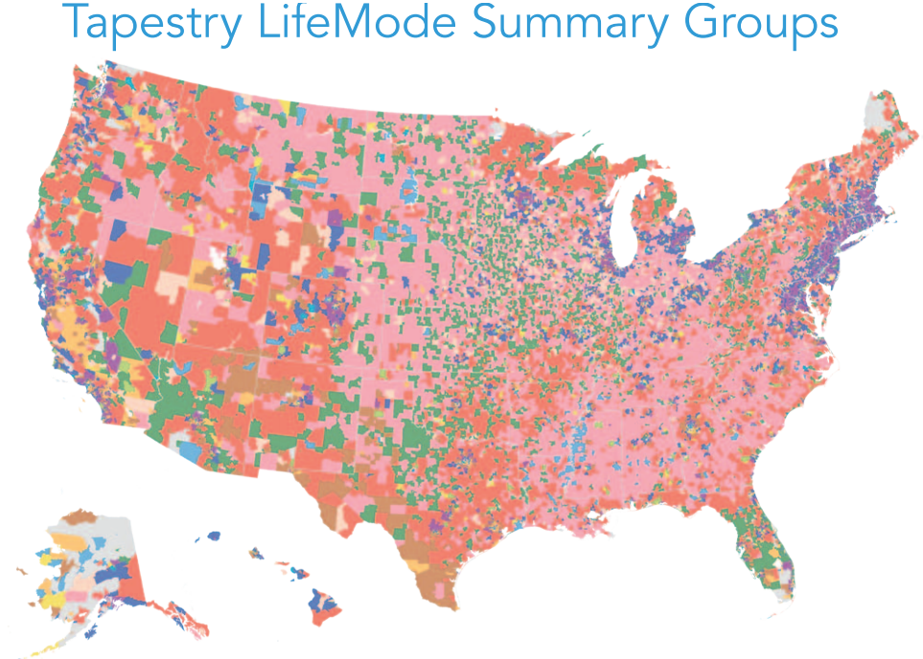
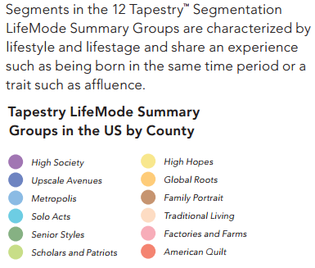
Example: ESRI Tapestry Data
Goal: to classify US consumers into many different clusters based on socioeconomic & demographic data from the US Census
Source: http://www.esri.com/library/whitepapers/pdfs/community-tapestry.pdf

Slide 5
In Practice…
The first time we do the analysis, we wouldn’t know how observations (i.e., regions) could be grouped into these tapestry clusters based on the available demographic and socio-economic variables
So we would run cluster analysis on those data and (hopefully) have a solution that yields interpretable and meaningful clusters
However… when we get new Census data, we may want to classify our regions into the same existing categories (i.e., clusters) using an algorithm like multinomial logistic regression or decision tree.

Slide 6
Nota Bene
Clustering may not be the best way to discover interesting groups in a data set. Often visualization methods work well, allowing the human expert to identify useful groups.
However, as the data set sizes increase to millions of observations, and the number of variables becomes large, this becomes impractical and clusters help to partition the data so that we can deal with smaller groups.
Source: http://togaware.com/onepager/ClustersL.pdf

Slide 7
Types of Clustering Algorithms
K-means / Partitional clustering (for numeric variables and large data set)
A division of objects into non-overlapping subsets (clusters) such that each object is in exactly one cluster
Majority of commercial data mining / machine learning and open source tools provide K-means clustering capability
Number of clusters is specified by a researcher / analyst in advance before running the clustering algorithm
Hierarchical clustering (only for numeric variables and small data sets)
A set of nested clusters organized as a hierarchical tree – that is, a hierarchy of clusters is built
Number of clusters is determined by a researcher as the result of hierarchical clustering
Agglomerative: This is a "bottom up" approach: each observation starts in its own cluster, and pairs of clusters are merged as one moves up the hierarchy.
Divisive: This is a "top down" approach: all observations start in one cluster, and splits are performed recursively as one moves down the hierarchy.
Density-based clustering (e.g., DBSCAN)
Given a set of points, the algorithm groups together observations that have many neighbors nearby
Points that are alone in low-density regions because their nearest neighbors are too far away are marked as outliers
DBSCAN is one of the most common clustering algorithms
DBSCAN stands for Density-Based Spatial Clustering of Applications with Noise

Slide 8
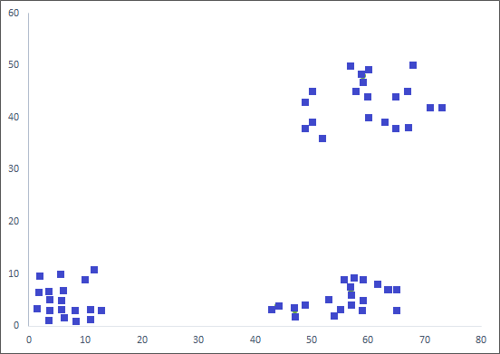
K-Means
Imagine you have 60 points which you want to place in a total of k=3 clusters based on the values of two variables (e.g., y=latitude and x=longitude)
Here’s a sample data set:

Slide 9
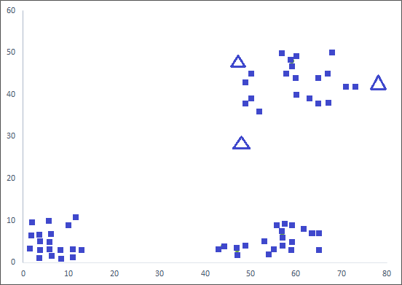
K-Means Algorithm in English
Figure out how many clusters (k) you would like.
In the example below, let’s say we want k=3 clusters.
Randomly guess where cluster centers are located.
In the example below, centers are represented by triangles, and are REALLY terrible guesses.

Slide 10
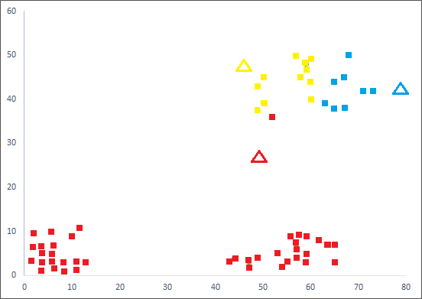
K-Means Algorithm in English (Cont’d)
Ask each data point to find the cluster “center” (triangle) that it is closest to (based on Euclidean distance)
All the points that are closest to:
the 1st triangle form preliminary cluster 1,
the 2nd triangle form preliminary cluster 2,
the 3rd triangle are in preliminary cluster 3.

Slide 11
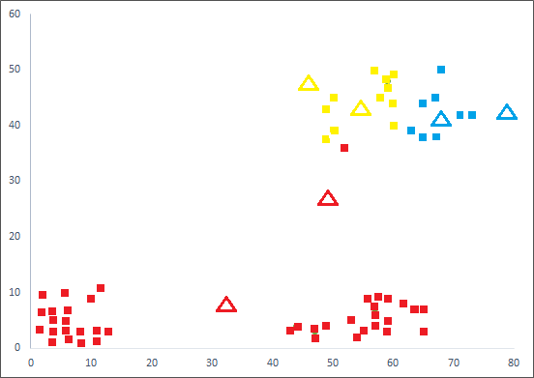
K-Means Algorithm in English (Cont’d)
Recalculate the centroids of the preliminary clusters 1, 2 and 3, as in the diagram below
Again, ask each data point to find the newly calculated centroid that it is closest to.

Slide 12
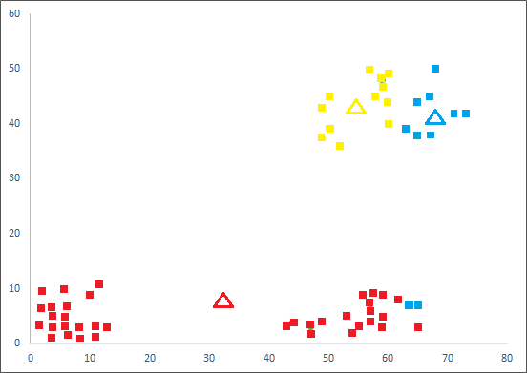
K-Means Algorithm in English (Cont’d)
Note that some points which were previously closer to the red triangle are now closer to the yellow, and some are now closer to the blue.
Again, recalculate the centroids of these clusters and ask each data point to find the newly calculated centroid that it is closest to. Some points will change cluster membership.

Slide 13
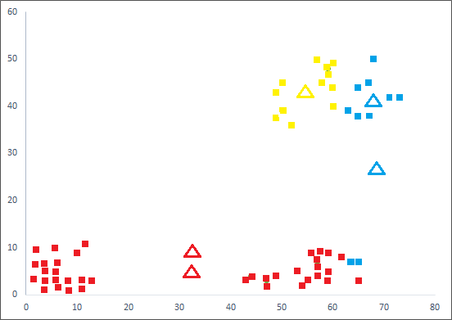
K-Means Algorithm in Diagrams

Slide 14
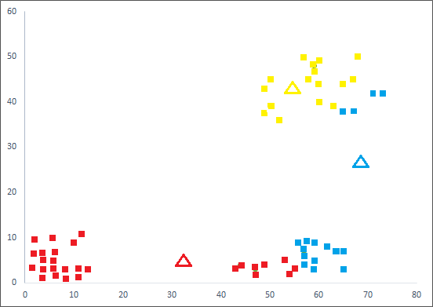
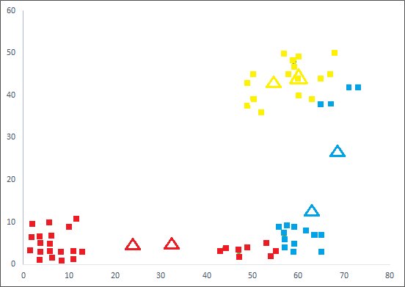
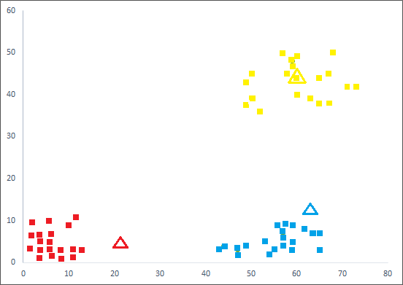
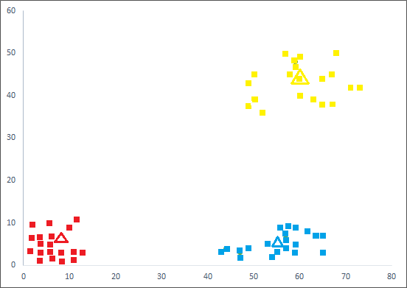
K-Means in Diagrams (Cont’d)

Slide 15
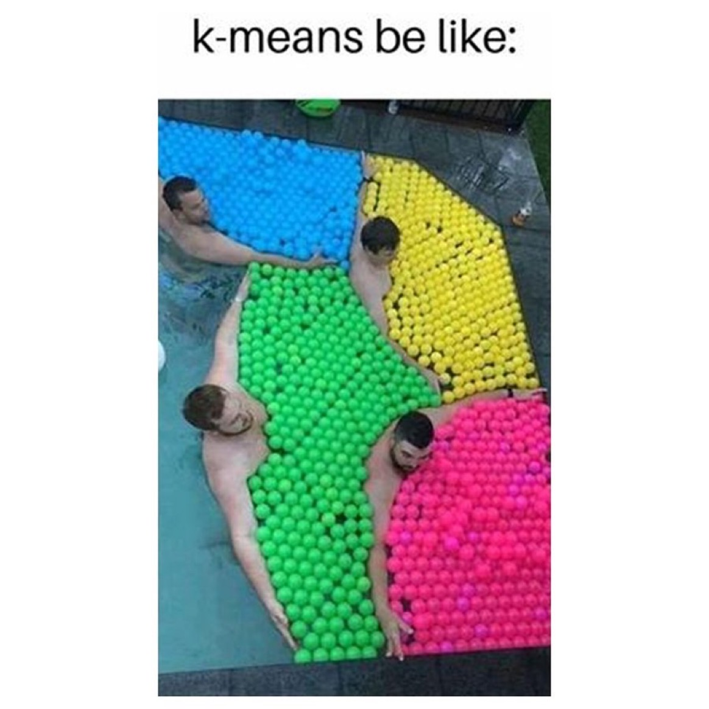

Slide 16
K-Means Algorithm in English (Cont’d)
Continue this process until no change in cluster membership occurs (or, for a certain number (e.g., 10) of iterations)
Final results are below.

Slide 17
Concisely Stated…
The number of clusters (K) is set a priori
6-step iterative process:
Randomly select K data points as cluster centers.
Calculate the distance between each data point and K cluster centers.
Assign each data point to a cluster whose distance from the cluster center is minimal among all cluster centers.
After all data points are assigned to a certain cluster, recalculate new cluster centers
Update the distance between each data point and new cluster centers.
If no data point was reassigned, stop; otherwise repeat from step 3
K-means minimizes the within-cluster sum of squared errors (SSE)
SSE: Sum of squared errors is calculated by doing the following for each cluster: compute the squared distance between each observation and the centroid of the cluster into which it falls, and sum these squared distances.
Overall K-means SSE is computed by summing these SSEs across clusters.
Another K-means algorithm visualization: http://www.tubechop.com/watch/6283076
And another one: https://www.youtube.com/watch?v=fQXXa-CAoS0

Slide 18
Do Variables Have To Be Lat & Lon?
Nope! Technically, they should be continuous, though some people will throw in binary variables (and ordinal variables with many categories) as well.
Imagine that your variables are years of education and annual income
We can come up with creative & descriptive names for clusters
Chief Twits
Education
Grumpy Cat &
Goofy
Honey Boo Boos
Income

Slide 19
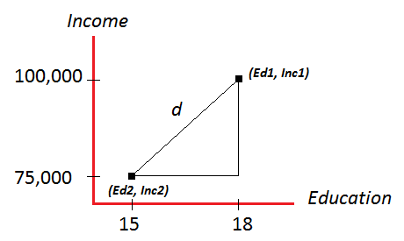
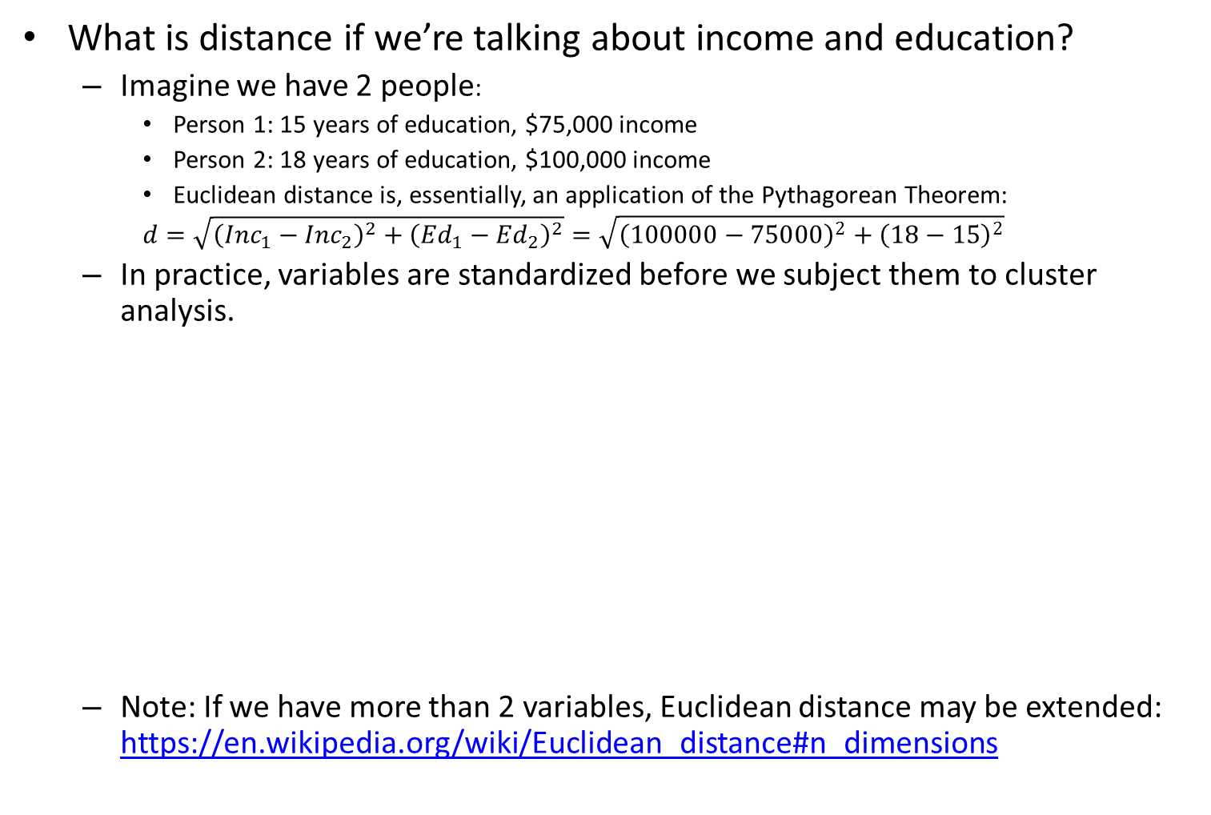
Euclidean Distance
What is distance if we’re talking about income and education?
Imagine we have 2 people:
Person 1: 15 years of education, $75,000 income
Person 2: 18 years of education, $100,000 income
Euclidean distance is, essentially, an application of the Pythagorean Theorem:
$$d=\sqrt{{\left({Inc}_{1}−{Inc}_{2}\right)}^{2}+{\left({Ed}_{1}−{Ed}_{2}\right)}^{2}}=\sqrt{{\left(100000−75000\right)}^{2}+{\left(18−15\right)}^{2}}$$
In practice, variables are standardized before we subject them to cluster analysis.
Note: If we have more than 2 variables, Euclidean distance may be extended: https://en.wikipedia.org/wiki/Euclidean_distance#n_dimensions

Slide 20
Some K-Means Kinks
Some versions of the algorithm will take k data points as an initial k cluster centroid rather than generate random points.
It’s often useful to try the algorithm with different initial values of the centroids and the clustering yielding the lowest SSE will generally be chosen
There is a way to do this in R
Some versions of the algorithm use non-Euclidean distance
There are versions of the algorithm that work for categorical variables and continuous/categorical variable mix
E.g., K-Modes algorithm – see more at https://shapeofdata.wordpress.com/2014/03/04/k-modes/
What happens when there’s a tie? (i.e., a point is equidistant to two or more centroids?)
Happens quite often with categorical data
Usually broken at random

Slide 21
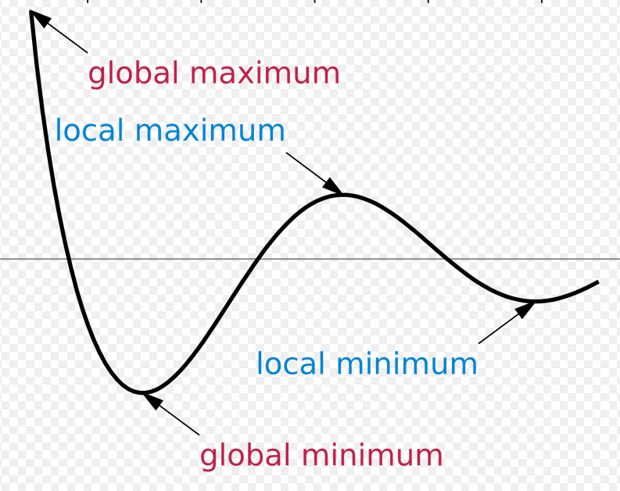
Limitations and Problems of K-Means
Necessity to specify K (number of clusters) in advance
Applicable for interval variables (only numeric data) – though again, some will throw in binary variables
Might have problems when clusters are of differing
Sizes
Densities
Non-globular shapes
Unable to handle noisy data and outliers
Occasionally, the final clustering solution will be incorrect, because k-means will find the local minimum of SSE, rather than the global minimum

Slide 22
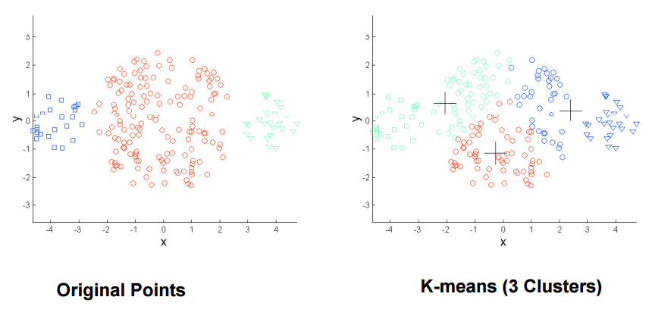
Problems with Identifying Clusters: Differing Sizes
Source: http://www.cs.uky.edu/~jzhang/CS689/PPDM-Chapter3.pdf

Slide 23
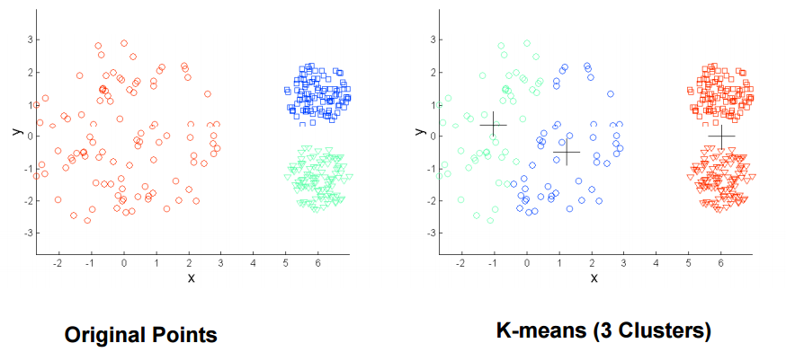
Problems with Identifying Clusters: Differing Densities
Source: http://www.cs.uky.edu/~jzhang/CS689/PPDM-Chapter3.pdf

Slide 24
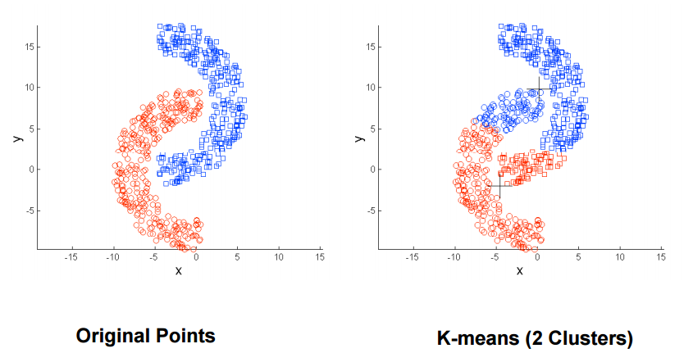
Problems with Identifying Clusters: Non-Globular Shapes
Source: http://www.cs.uky.edu/~jzhang/CS689/PPDM-Chapter3.pdf

Slide 25
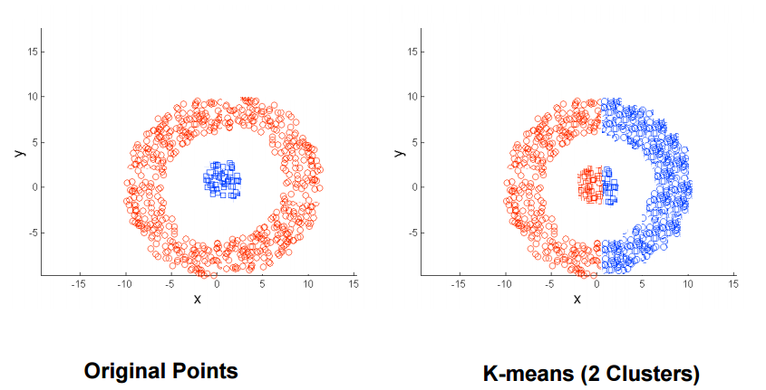
Problems with Identifying Clusters: Non-Globular Shapes

Slide 26
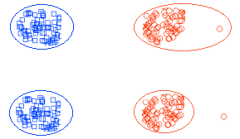
Problem with Identifying Clusters: Outliers
Instead of leaving point out altogether, it becomes part of the red cluster, heavily influencing it
Undesirable Clusters
Ideal Clusters
Outlier
Source: http://image.slidesharecdn.com/15857cse422-unsupervised-learning-141110112626-conversion-gate01/95/15857-cse422-unsupervisedlearning-21-638.jpg?cb=1415618812

Slide 27
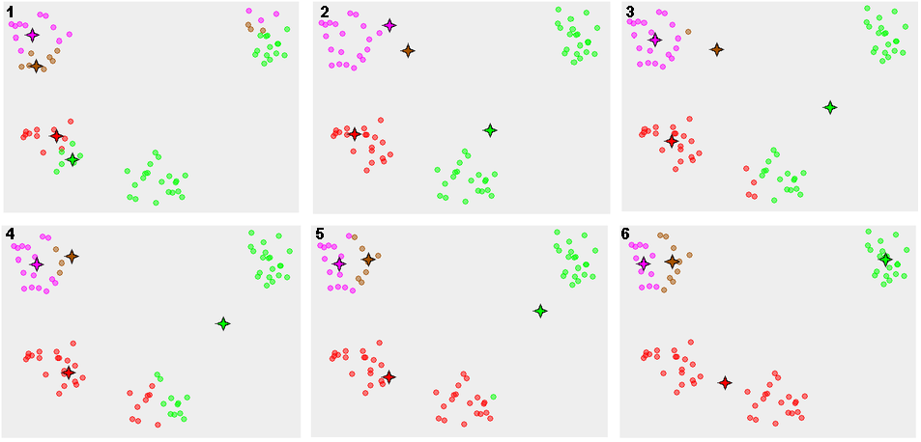
Problem with Identifying Clusters: Convergence to Local Minimum SSE
Source: https://en.wikipedia.org/wiki/K-means_clustering

Slide 28
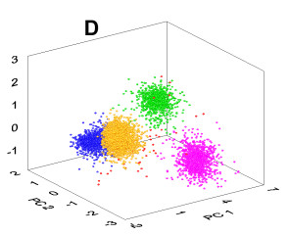
K-Means: Same Idea In 3+ Dimensions
Source: http://www.biomedcentral.com/content/figures/1471-2202-13-96-10.jpg

Slide 29
Choosing the Number of Clusters
Eternal question: what is the number of clusters that we should use? That is, how do we know what k should be?
There are dozens of methods which statisticians and data mining experts use to identify the best number of clusters
Different methods optimize different quantities
They often disagree about what the optimal number of clusters should be
The NbClust package in R has up to 30 methods for choosing the optimal number of clusters
For more information, see: https://cran.r-project.org/web/packages/NbClust/NbClust.pdf
In practice: for K-means, you may want to use the number of clusters that’s considered optimal by the largest number of methods in NbClust.

Slide 30
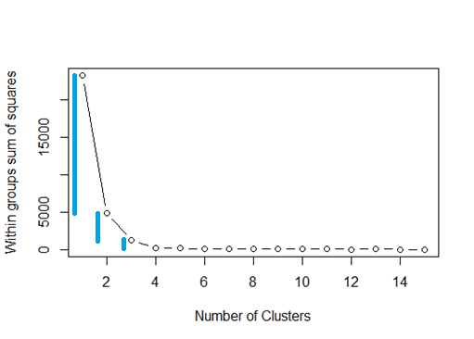
One Useful Method: The Scree Plot
Identify the bend in the “elbow” of the scree plot – i.e., the point where the drop in the within group Sum of Squared Errors becomes very small.
In the graph above, the drop in SSE between 1 and 2 clusters is vast, the drop between 2 and 3 clusters is pretty substantial, the drop between 3 and 4 clusters is somewhat noticeable, and the drop between 4 and 5 clusters is essentially 0.
That is, there’s little drop in SSE when we increase the number of clusters from 4 to 5, 6, etc.
So we stick with the 4 cluster solution based on the scree plot.

Slide 31
Other Useful Metrics for # Clusters
The D-index calculates the second differences of the within-cluster variances for different numbers of clusters, helping to identify the point (the elbow) where adding more clusters does not significantly improve the fit.
On the other hand, the Hubert Index is a measure of the agreement between the distances among data points and the structure of the clustering. It compares the pairwise distances of data points to the clusters they are assigned to. A higher Hubert Index value indicates a better clustering structure, where data points within the same cluster are closer to each other, and those in different clusters are farther apart.

Slide 32
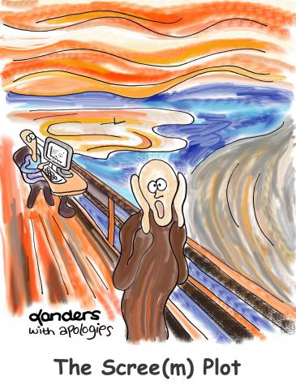

Slide 33
Doing It All In R
install.packages("NbClust")
install.packages("flexclust")
library(NbClust)
library(flexclust)
setwd("C:/Users/eugeneby/Downloads")
Code based on: http://www.r-statistics.com/2013/08/k-means-clustering-from-r-in-action

Slide 34
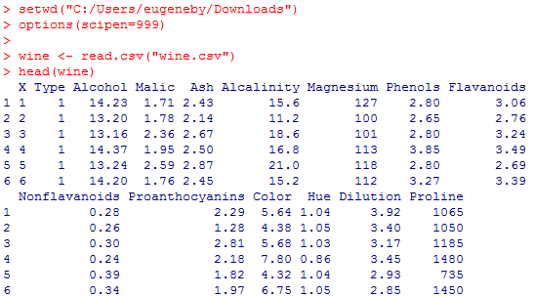
Doing It All In R (Cont’d)
The data set wine.csv has 178 observations
More information on data: http://www.inside-r.org/packages/cran/rattle/docs/wine.
Each observation is a sample of wine - numerous characteristics for each sample available
The variable Type indicates the type (i.e., class) of each wine: e.g., merlot, cabernet, etc.
Can we use K-means with the variables [Alcohol … Proline] to cluster the samples of wine?
Can we see how well our clusters fare in comparison with the wine type that’s available (i.e., classification of wine)?
This is something that we usually cannot do with cluster analysis.

Slide 35


Slide 36
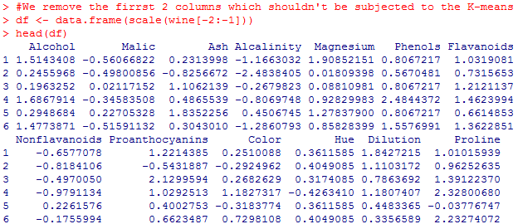
Doing It All In R (Cont’d)
The data.frame command below converts the data set wine (without the first two variables – X and Type) into an R data frame.
The scale command standardizes the variables, so that the means of the variables are 0 and standard deviations are 1.
This is needed for cluster analysis.

Slide 37
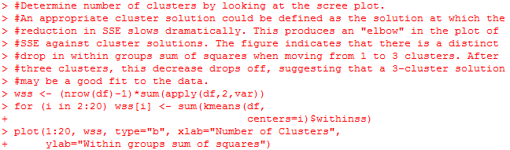
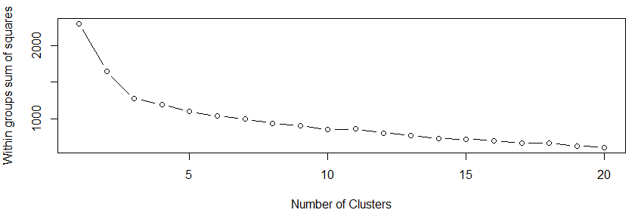
Doing It All In R (Cont’d)
Elbow at k = 3

Slide 38
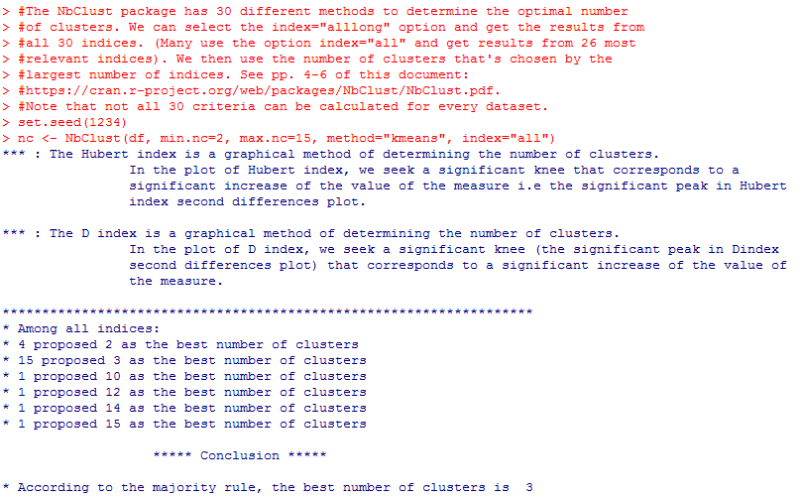
Doing It All In R (Cont’d)

Slide 39
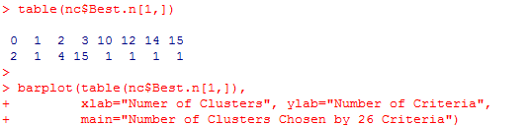
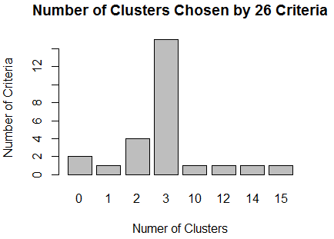
Doing It All In R (Cont’d)
Ignore the instances where the suggested number of clusters is 0 or 1: it’s not very helpful to us.

Slide 40
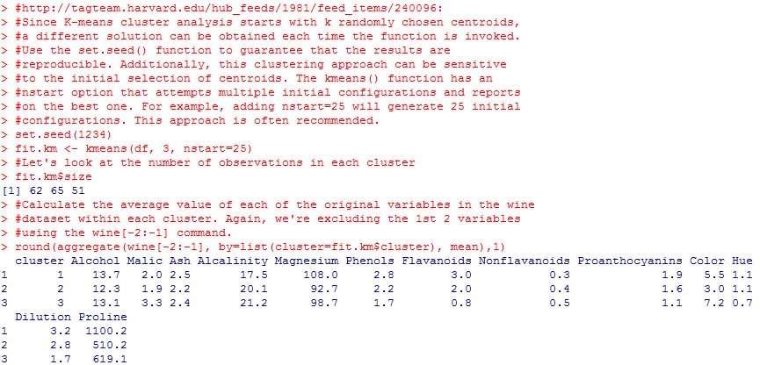
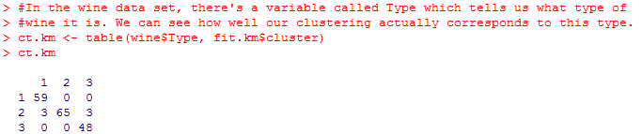
Doing It All In R (Cont’d)

Slide 41
Hierarchical Clustering
Again, method doesn’t have some of the limitations of k-means
However, it works well with smaller data sets and not so well with larger data sets
You do not need to input the number of clusters: any number of clusters may be chosen based on a dendrogram, or a cluster tree
More on hierarchical (agglomerative) clustering: https://www.youtube.com/watch?v=XJ3194AmH40

Slide 42
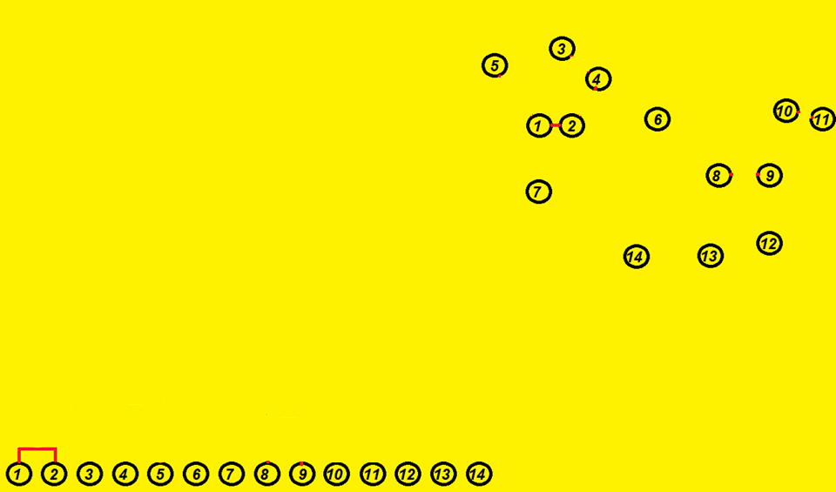
Find 2 Points Closest To Each Other (1 & 2)
Dendrogram
# Clusters
Distance Threshold

Slide 43
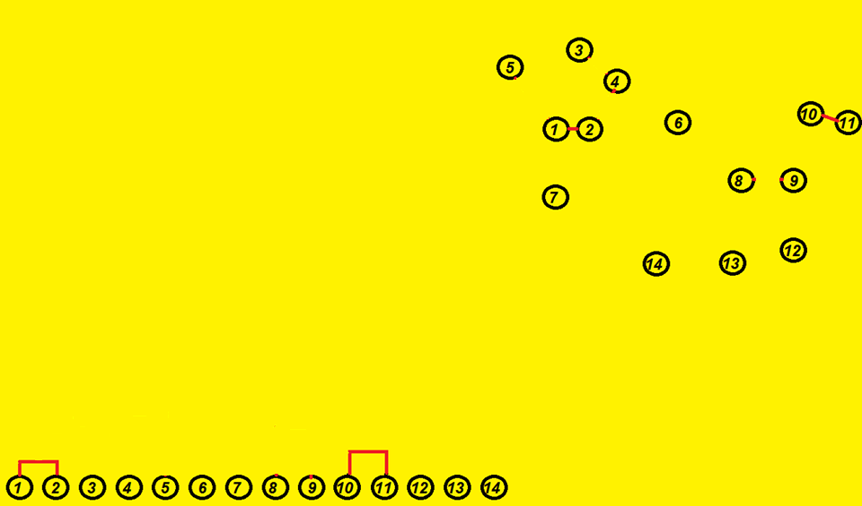
Find the Next 2 Points Closest to Each Other
Dendrogram
# Clusters
Distance Threshold

Slide 44
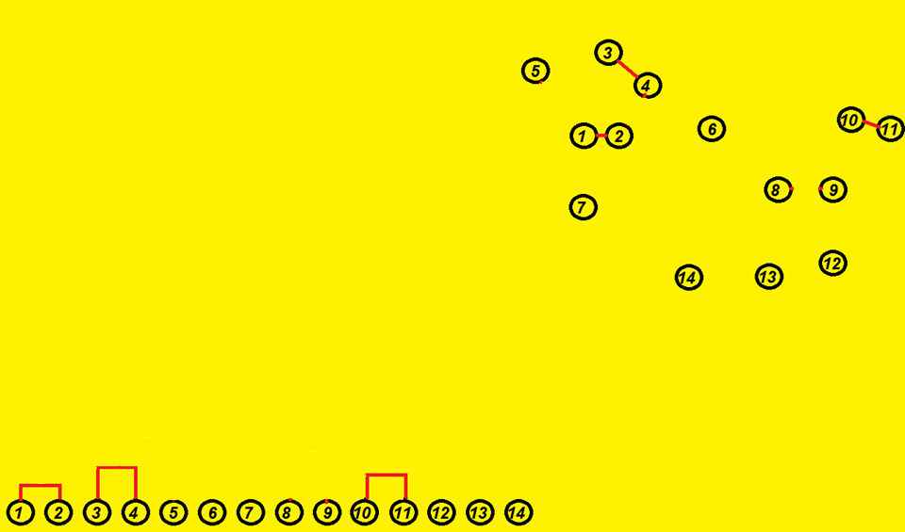
And the Next 2 Points
Dendrogram
# Clusters
Distance Threshold

Slide 45
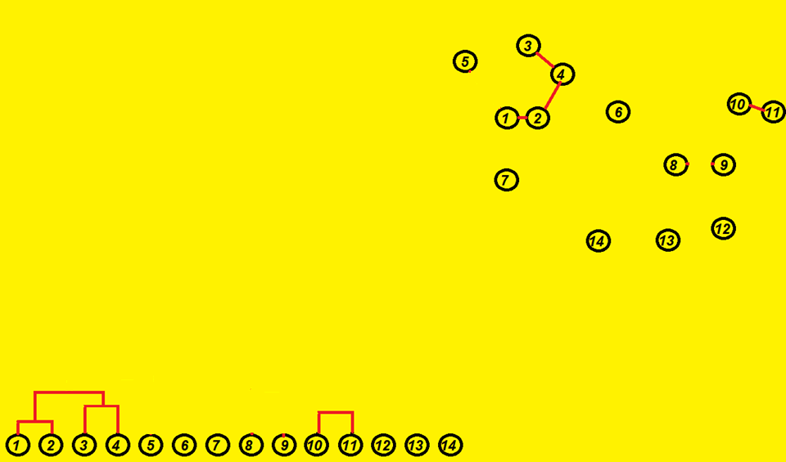
And So On…
Dendrogram
# Clusters
Distance Threshold

Slide 46
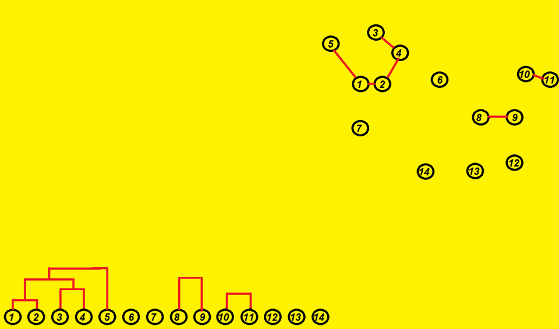
And So On…
Dendrogram
# Clusters
Distance Threshold

Slide 47
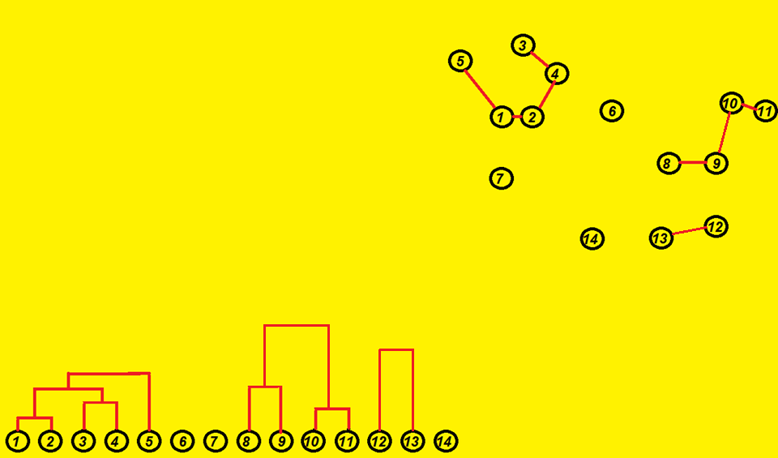
And So On…
Dendrogram
# Clusters
Distance Threshold

Slide 48
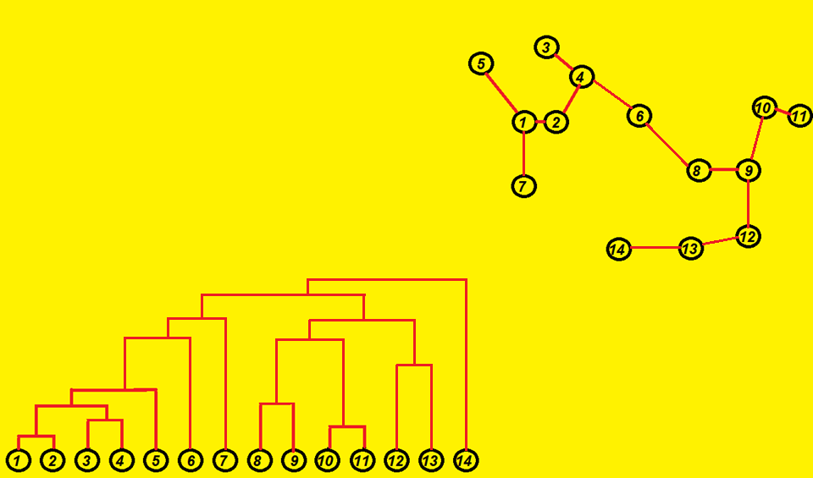
… Until All Points Are Accounted For
Dendrogram
# Clusters
Distance Threshold

Slide 49
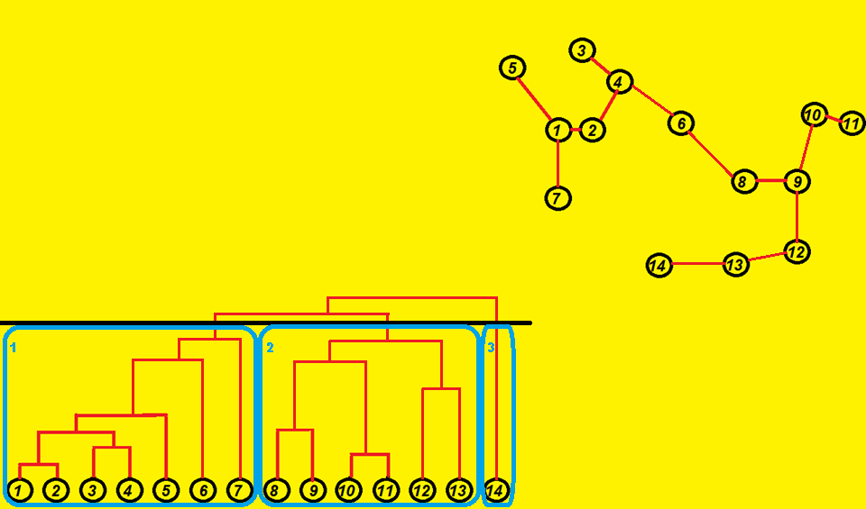
Imagine We Want a 3 Cluster Solution
Dendrogram

Slide 50
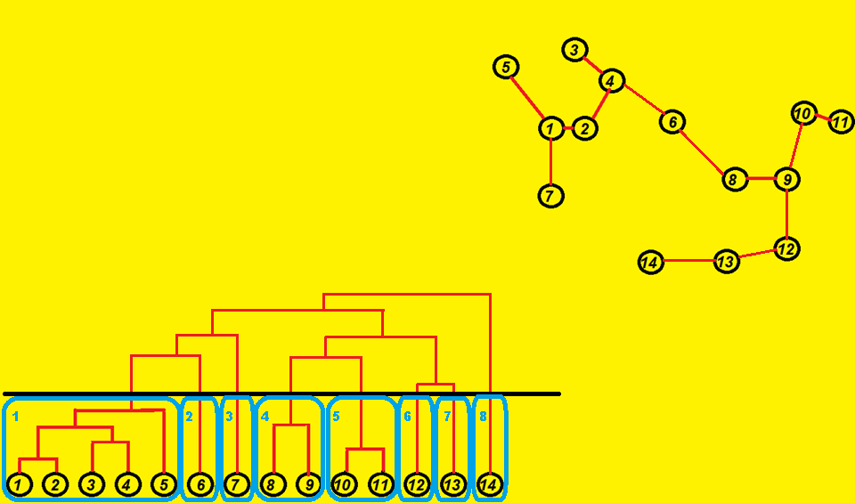
… Or an 8 Cluster Solution
Some of the larger clusters from the previous slide are simply split into more clusters based on the dendrogram. Here, clusters 1, 2 and 3 are part of the first cluster on the previous slide. That is, based on the dendrogram, there is a hierarchy of clusters. Hence the name, hierarchical clustering.
Dendrogram

Slide 51
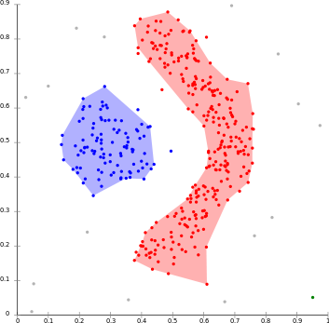
DBSCAN: Density-Based Clustering
Can identify irregular cluster shapes
Observations that have many neighbors nearby grouped together in a single cluster
Observations whose nearest neighbors are too far away are outliers and aren’t part of any cluster
x2
Implementation of DBSCAN in R may be seen here:
http://www.sthda.com/english/articles/30-advanced-clustering/105-dbscan-density-based-clustering-essentials/
x1

Slide 52
DBSCAN: Density-Based Clustering
The goal is to identify regions that are dense – that is, regions where points have many neighbors.
DBSCAN has 2 parameters, which are set by the user
Epsilon (eps): radius of neighborhood around a point x, and
MinPts: minimum number of neighbors within radius eps that are needed to form a cluster

Slide 53
DBSCAN: Some Core Concepts
The way it works is as follows:
Draw a circle of radius eps around point p₁
If number of other points (i.e., neighbors) within that circle ≥ MinPts, then p₁ is marked as a Core Point
If number of other points within that circle < MinPts, but p₁ is within radius eps of some other Core Point p₂, then p₁ is a Border Point
If p₁ is neither a Core Point nor a Border Point, it is an Outlier.
This is done for all points p_{i}, i=1..n

Slide 54
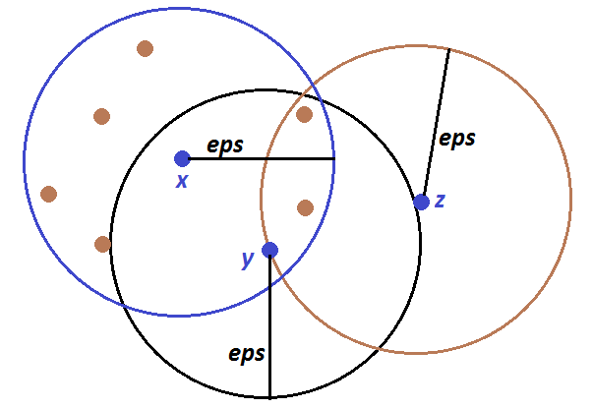
Example: Imagine MinPts = 6
In the image below we have the following:
For x, there are 7 other points which are within a radius of eps. Because 7 > MinPts, x is a Core Point.
For point y, there are only 3 other points within a radius of eps. Because 3 < MinPts, y is not a Core Point. However, because y is within radius eps of Core Point x, y is a Border Point.
For point z, there are only 2 other points within a radius of eps. Because 2 < MinPts, z is not a Core Point. Furthermore, because z is not within radius eps of any Core Point, z is not a Border Point. Because z is neither a Core Point nor a Border Point, z is an outlier.

Slide 55
Reachability: Directly Density Reachable
Point p₁ is directly density reachable from another point p₂ if 2 conditions hold:
p₁ is within radius eps of p₂
p₂ is a core point
Example (again, MinPts = 6)
In the figure, y is directly reachable from x because:
y is within radius eps of x
x is a core point
However, is x directly density reachable from y?

Slide 56
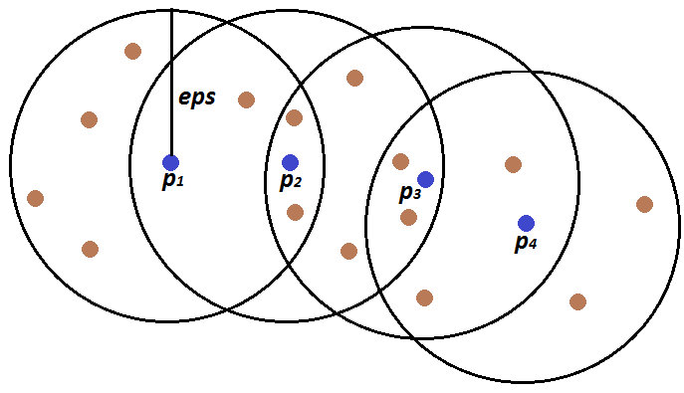
Reachability: Density Reachable
Point p_{k} is density reachable from another point p₁ if in the chain of points p₁,…, p_{k}, each point p_{i+1} is directly density reachable from previous point p_{i}.
Example (again, MinPts = 6):
In the figure, we look at 4 blue points, p₁,…, p_{k=4}. Here:
Point p₂ is directly density reachable from point p₁ (and vice versa),
Point p₃ is directly density reachable from point p₂ (and vice versa),
Point p₄ is directly density reachable from point p₃ (and vice versa).
This means that point p₄ is density reachable from point p₁.
Likewise, point p₁ is density reachable from point p₄.

Slide 57
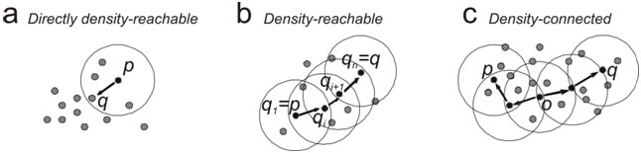
Reachability: Density Connected
Point p₁ is density connected to another point p₂ if there is a third point p₃ such that both p₁ and p₂ are density reachable from p_{3.}
By definition, density connectivity is symmetric – that is, if p₁ is density connected to p₂, then p₂ is density connected to p₁.
Example:
In Figure (C) below, points q and p are both density reachable to point o, meaning that q and p are density connected.
Source: http://www.dmi.unict.it/~cassisi/DBStrata/help/img/dbscandefinitions.jpg

Slide 58
How DBSCAN Works
Here’s an approximate description of how DBSCAN works:
Take each point p_{i}.
Calculate the distance between it and all the other points.
Find all the points within distance eps of p_{i}.
If p_{i} has at least as many neighbors as MinPts, then p_{i} is a Core Point.
For each Core Point, if it’s not already assigned to a cluster, create a new cluster. Then, find all its density connected points and assign them to the same cluster as the Core Point.
Iterate through the remaining unvisited points in the data set.
Said differently, we need to find out all the maximal density-connected spaces and form clusters from them (http://www.sersc.org/journals/IJSIP/vol6_no1/9.pdf ).
Points that do not belong to any cluster are outliers.
How to determine the values for eps and MinPts:
http://www.sersc.org/journals/IJSIP/vol6_no1/9.pdf
Source for this and previous slides: http://www.sthda.com/english/articles/30-advanced-clustering/105-dbscan-density-based-clustering-essentials/

Slide 59
ST-DBSCAN: Spatio-Temporal Clustering
Can be used to identify clusters from spatio-temporal clusters
Roughly speaking, points which are within a certain distance and a certain amount of time of one another form a cluster
I use ST-DBSCAN in some of my work to identify clusters (i.e., destinations) from GPS data
Methods detailed in:
Brusilovskiy, E., Klein, L. A., & Salzer, M. S. (2016). Using global positioning systems to study health-related mobility and participation. Social Science & Medicine, 161, 134-142.

Slide 60
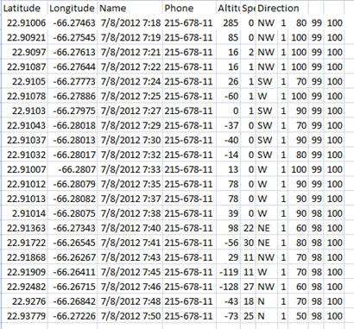
Gathering GPS Data
We tracked ~120 individuals with serious mental illnesses with a GPS-enabled phone using AccuTracking, a cell phone app that gathers location information at 1 minute intervals.
Location information was eventually imported into GIS (Google Earth and ArcGIS), enabling us to visualize the participants’ mobility over the two-week time frame.

Slide 61
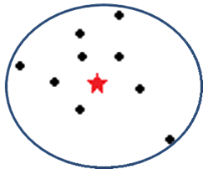
Community Mobility Construct: Identifying Destinations
We can attempt to identify locations at which individuals spend a substantial amount of time (e.g., 20 minutes or more)
However, there is noise in the GPS data: even when the GPS is in the same location, the recorded latitude and longitude may differ
ST-DBSCAN would be a good way to identify destinations from the GPS data

Slide 62
ST-DBSCAN
Spatio-Temporal Density-Based Spatial Clustering of Applications with Noise (ST-DBSCAN) (Birant, D. and A. Kut 2007).
ST-DBSCAN can be implemented in the open source RapidMiner package, and the code which we used was written by Alex Fechner – and also in R.
Our write up is here: http://www.tucollaborative.org/wp-content/uploads/Tracking-community-mobility-technical-report-final-2020-1.pdf
The number of clusters that are identified by ST-DBSCAN depends on 3 parameters, the values of which are set by the user.

Slide 63
ST-DBSCAN Parameters
The parameters used in this study are the following:
MinPts: Minimum # of points needed to form a cluster (we set this to 10)
Eps1: Spatial distance for points to be within a cluster (we set this to 200 meters)
Eps2: Non-spatial (i.e., temporal) distance (we set this to 20 minutes)
We identify clusters, or destinations, using the ST-DBSCAN parameter values specified above
(Very) roughly speaking, if we have at least 10 points which are within 200 meters of one another & where consecutive points are within 20 minutes of one another, we have a cluster.
Points that aren’t in a cluster (destination) are considered to be in-transit points!

